Slide 1


Leveraging Earth Observation Data for Informed Agricultural Decision-Making
Brett Muir
Sina Abbasi
Sandy West
Christopher Kinyua
Parker Link
Meagan Davies
Notes:
My name’s Brett and our team is Calgary To Space.

Slide 2
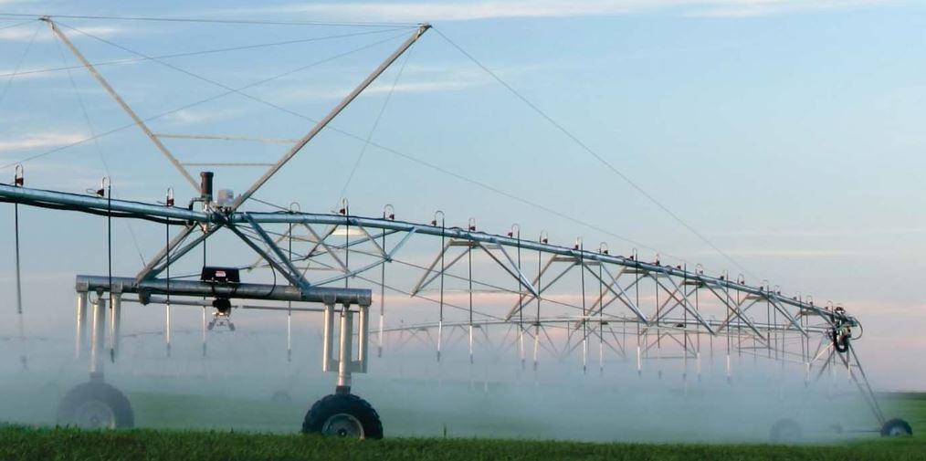
Inspiration
Notes:
Inspiration:
Our home province Alberta is the irrigation capital of Canada. Irrigation related activities contribute over $5.4 billion dollars towards provincial GDP.
We wanted to give farmers a way to affordably optimize their water use.
Image:
https://open.alberta.ca/dataset/749d1022-74a5-4779-9c33-b57fcd05109c/resource/45061279-1f9c-4df4-bcfb-b77479de4355/download/6734585-2014-albertas-irrigation-strategy-future-2014-06-03.pdf

Slide 3
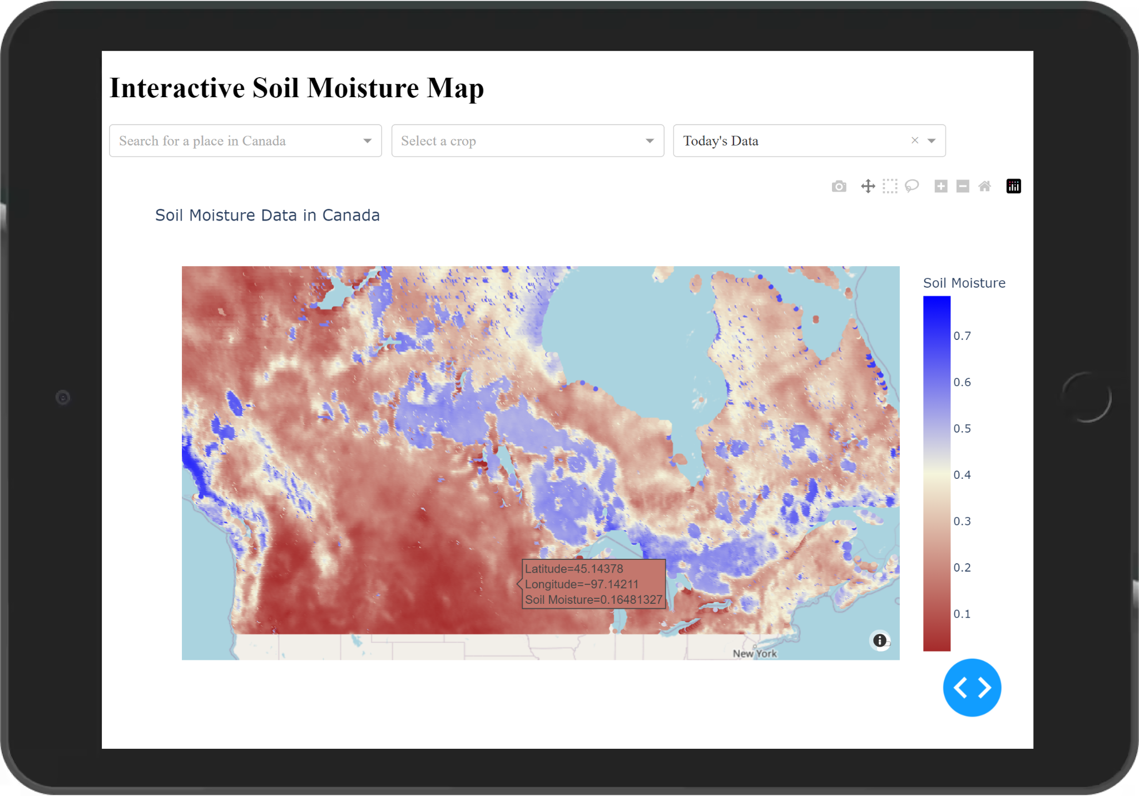
CaSoMo
Canadian Soil Moisture
Notes:
Using data from the SMAP (Soil Moisture Active Passive) Satellite missions we are able to provide farmers intuitive access to daily soil moisture data across Canada.
References: SPL3SMP_E doi:10.5067/M20OXIZHY3RJ

Slide 4


Slide 5
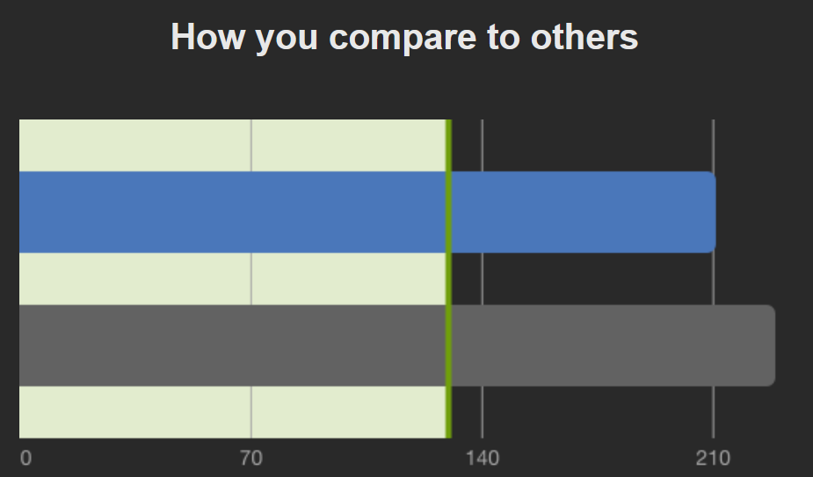
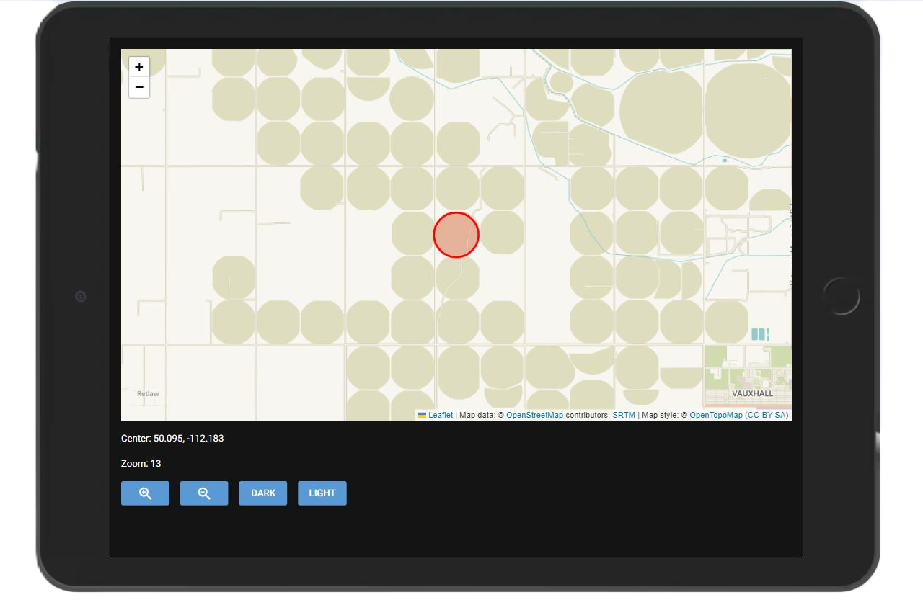
Alerts for Under or Over Watering
Regional and Crop Specific Comparisons

Slide 6
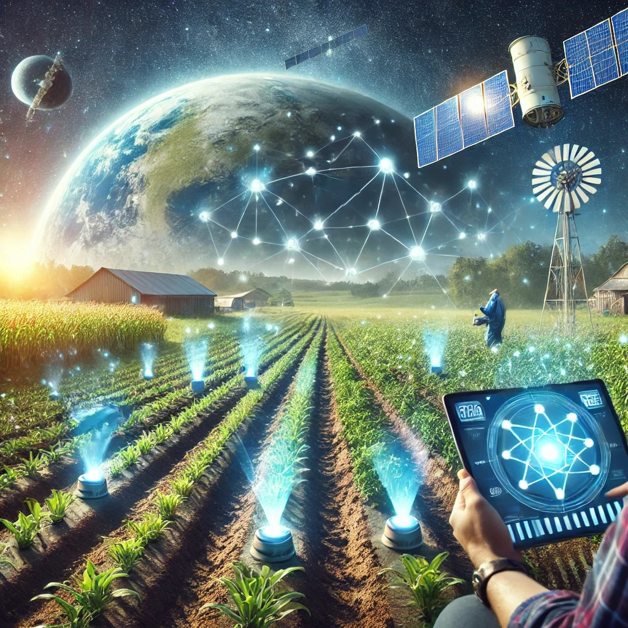
Empowering farmers to make data driven decisions Their ground truth feedback can enable future integration of IOT and AI forecasting
Notes:
Generated with OpenAIs Dalle3

Slide 7

#CalgaryToSpace
https://www.calgarytospace.ca/
Notes:
Generated with OpenAIs Dalle3

